Slide 1

Course Name- Production Technology for Ornamental Crops, MAP and Landscaping
Course Code- 20014400
Presented By- Dr. Mahendra Kr. Yadav
B.Sc. (Ag.) IV Sem. (Production Technology for Ornamental Crops, MAP and Landscaping)

Slide 2
Course Objectives
Identify different types of ornamental and medicinal crops.
Examine various principles of landscaping, uses of landscape trees, shrubs and climbers, production technology of important ornamental crops, etc.
Determine about Demonstrate various Package of practices for loose flowers and their transportation, storage house and required condition for cut and loose flower.
Construct about the various problems with the production technology of medicinal and aromatic plants.
Importance of Processing and value addition in ornamental crops and MAPs produce.
B.Sc. (Ag.) IV Sem. (Production Technology for Ornamental Crops, MAP and Landscaping)

Slide 3
Production technology of rose under protected conditions
B.Sc. (Ag.) IV Sem. (Production Technology for Ornamental Crops, MAP and Landscaping)

Slide 4
ROSE
King of Flowers, Queen of Flowers
Botanical Name - Rosa indica
Rosa hybrida
Rosa sinensis
Family – Rosaceae,
Origin – USA, 2n = 14
Most favourite flower of world.
It ranks first in global cut flower trade. Also grown for essential oil, rose water and gulkand.
Dr. B.P. Pal played a significant role in the rose breeding in India, he is known as "Father of Indian Roses
B.Sc. (Ag.) IV Sem. (Production Technology for Ornamental Crops, MAP and Landscaping)

Slide 5
Importance and uses:
1 | Shrub or bush | 7 | Hangers
2 | Standard rose | 8 | Cut flowers
3 | Climbers | 9 | Perfume and allied products
4 | Hedges & Edges | 10 | Rose water
5 | Rockery | 11 | Source of vitamins
6 | Pot plant | 12 | Other value added products
B.Sc. (Ag.) IV Sem. (Production Technology for Ornamental Crops, MAP and Landscaping)

Slide 6
Classes of roses:
Hybrid teas | Polyanthas | Cabbage roses | Musk roses
Floribundas | China roses | Moss roses | Noisette roses
Hybrid perpetual | Miniatures | Fresh roses | Rugosus
Teas | Damask roses | Albas | Austrian briars
Grandifloras | Bourbon roses | Ramblers | Local/Desi
B.Sc. (Ag.) IV Sem. (Production Technology for Ornamental Crops, MAP and Landscaping)

Slide 7
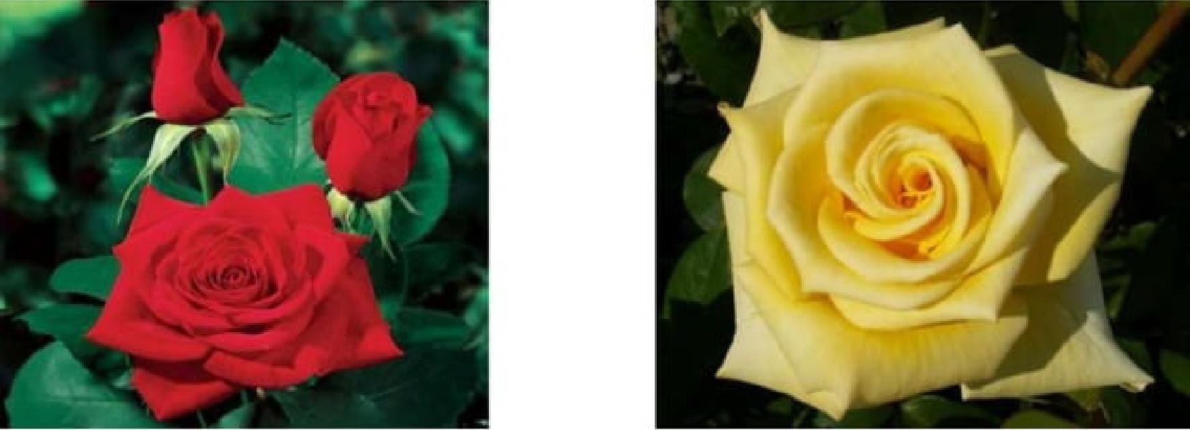
1. Hybrid Tea:
Originally developed from crossing between Hybrid Perpetuals x Tea roses.
Most popular rose.
Bearing large highly centered single flowers.
‘La France’ (1867) – First cultivar of hybrid tea group developed by Guillot.
Eg. Dr. B.P. Pal, Sungandha, Arjun, Dr. Homi Bhabha, Ganga, Ajanta, Blue moon, Super star, Paradise, Mr. Lincoln, Confidence, John of Kennedy, Golden Giant, First Prize, Happiness, Gladiator, Kiss of Fire, Careless Love, etc.
B.Sc. (Ag.) IV Sem. (Production Technology for Ornamental Crops, MAP and Landscaping)

Slide 8
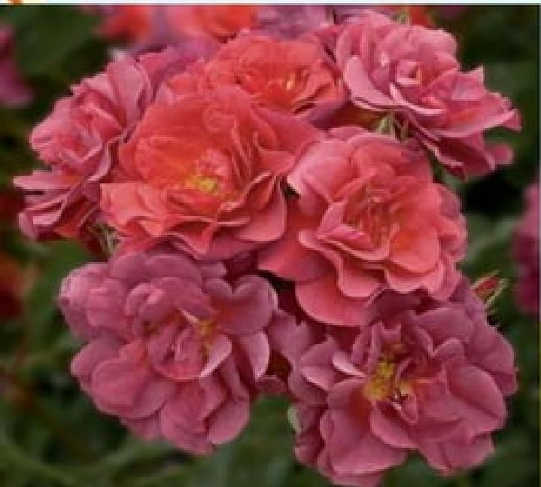
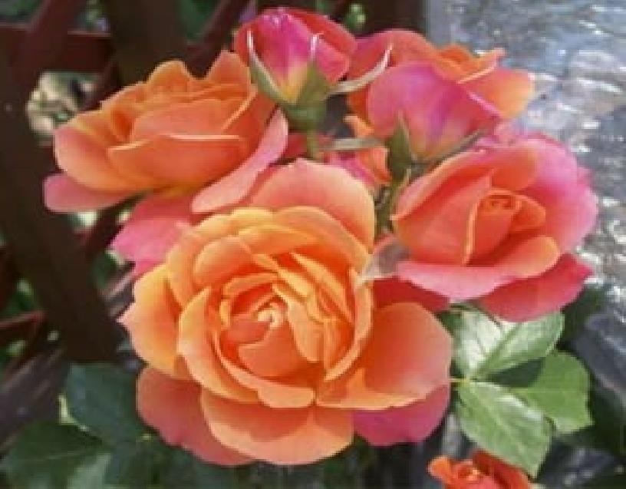
2.Floribunda:
Developed in 1924 from the cross between a Hybrid Tea x Polyantha.
Flowering in clusters with small size and open centre.
Good for garden display.
Eg. Delhi Princes, Rupali, Prema, Banjaran, Mohini, Chandrika, Iceberg, Summersnow, Hemngini, Queen Elizabeth, Golden Raise, Susama, etc.
B.Sc. (Ag.) IV Sem. (Production Technology for Ornamental Crops, MAP and Landscaping)

Slide 9
3. Polyanthas:
Dwarf with small flowered.
Polyanthas are the forerunner of Floribundas.
Blooms for several months.
Their Ancestry includes crosses of R. multiflora and R. wichuraiana (Climber) and the Bengal hybrid R. indica major (R. chinensis).
Eg: La Paquorette (1875), Baby Faurax (1924), Echo (1914).
B.Sc. (Ag.) IV Sem. (Production Technology for Ornamental Crops, MAP and Landscaping)

Slide 10
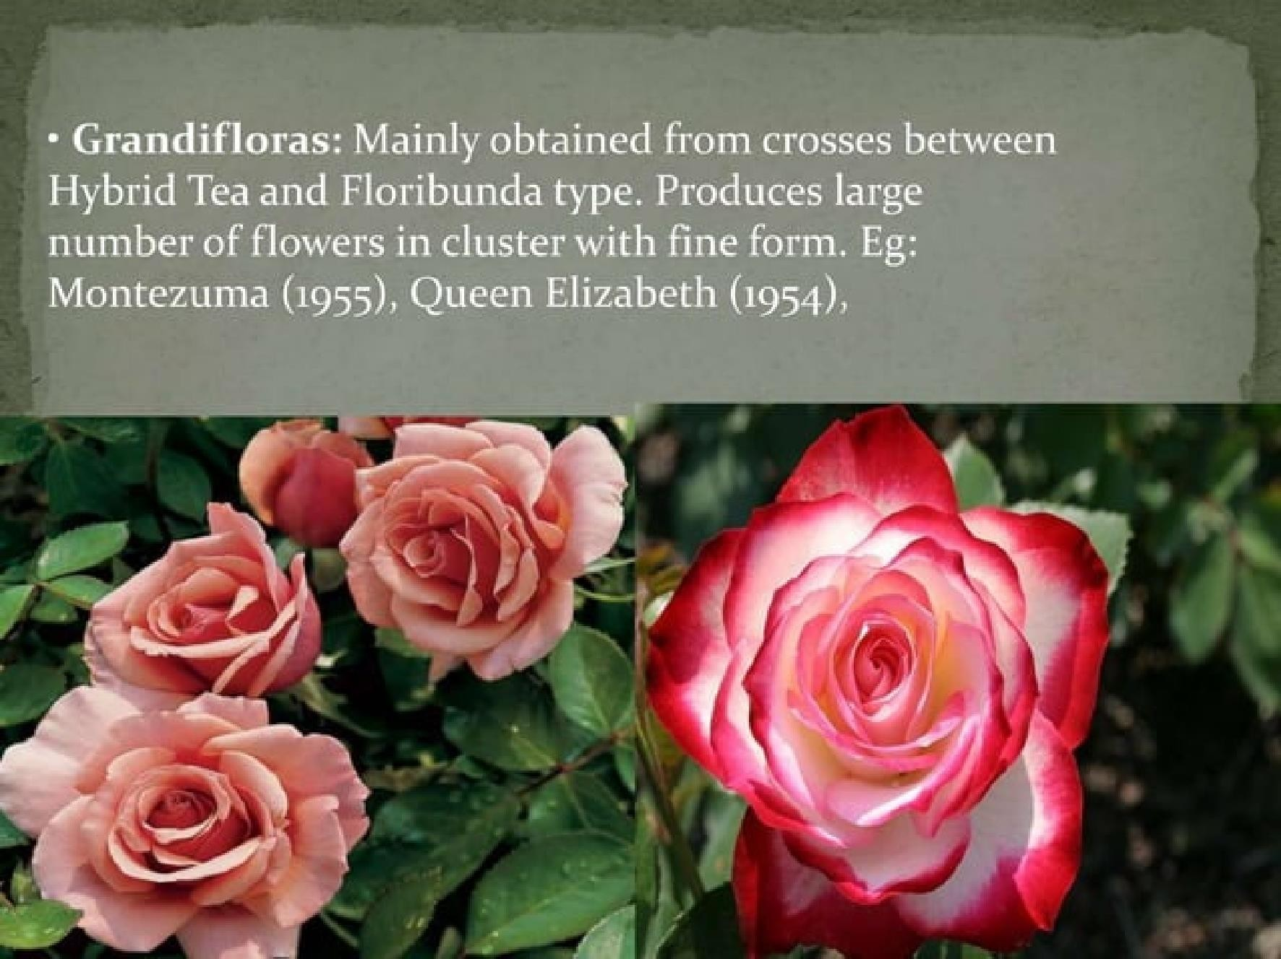
B.Sc. (Ag.) IV Sem. (Production Technology for Ornamental Crops, MAP and Landscaping)

Slide 11
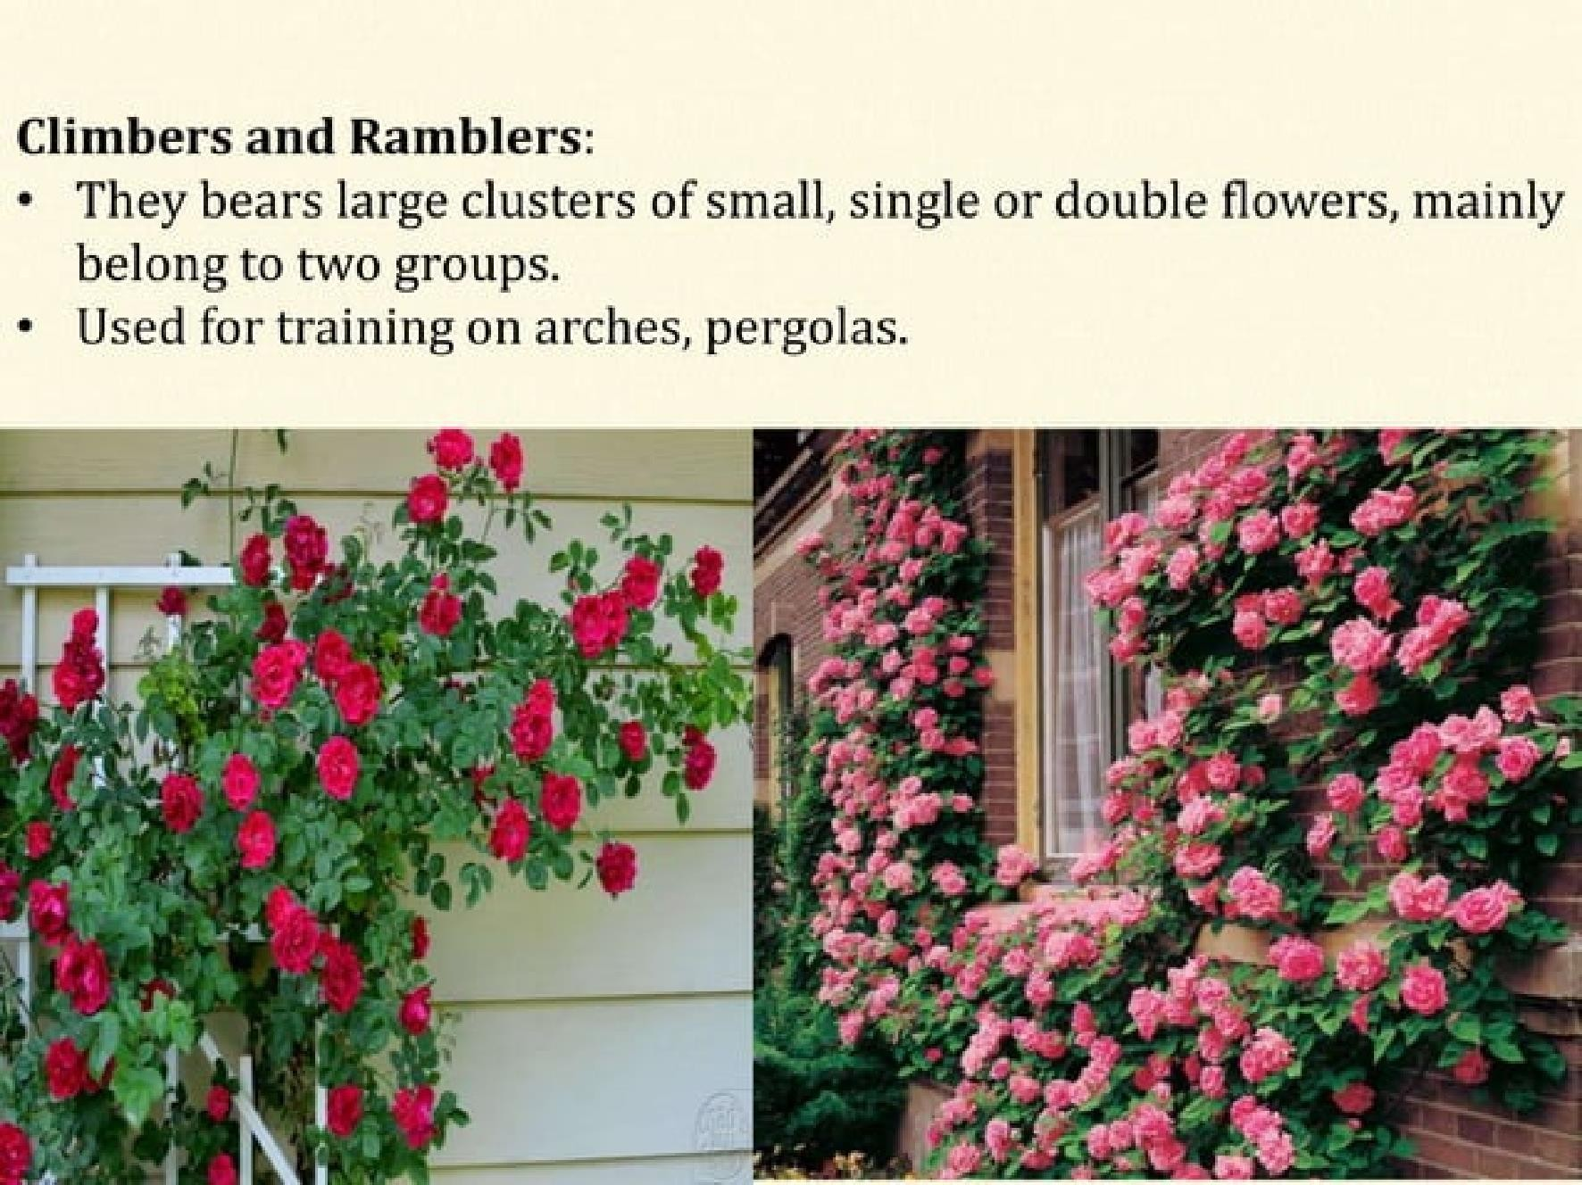
B.Sc. (Ag.) IV Sem. (Production Technology for Ornamental Crops, MAP and Landscaping)

Slide 12
Types of Roses -
Long stemmed roses (70-90 cm) - Large flower :-Hybrid tea
Medium stemmed roses (50-70 cm) - Intermediate flower :- Floribunda
Short stemmed roses (30-50 cm) - small flowers:- Sweet heart roses
Spray Roses -Spray:- Spray floribundas
Miniature roses- small flowered:- Sweet heart roses
B.Sc. (Ag.) IV Sem. (Production Technology for Ornamental Crops, MAP and Landscaping)

Slide 13
Soil & Climate –
Ideal soil for rose cultivation should be well drained, medium loam soil with a pH of 5.5 to 6.5.
Rose is a sun loving plant
requires high light intensity,
Optimum day and night temperature requirement is 24 – 26o C and 15 – 17oC, respectively,
75 per cent relative humidity and
CO2 level up to 1000 ppm
B.Sc. (Ag.) IV Sem. (Production Technology for Ornamental Crops, MAP and Landscaping)

Slide 14
Propagation:
Hybrid Teas and Floribunda
: ‘T’ Budding.
Polyantha, Miniatures, Climbers : Stem cuttings
Desi Roses : Air Layering or Cuttings.
Common rootstocks used for budding:
Rosa bourboniana (Edourad/ Bourbon rose)
R. indica var. Odorata
R multiflora var. inermis
B.Sc. (Ag.) IV Sem. (Production Technology for Ornamental Crops, MAP and Landscaping)

Slide 15
Land and Bed Preparation –
Generally in greenhouse, roses are grown on raised beds to assist in easier movement and better drainage.
Land should be ploughed thoroughly
Add well decomposed FYM @ 8-10 kg/m²
Bed size: 1-1.6 m wide, 30-40m long and 15-20cm/ 30-40cm height Space between Bed : 0.5-0.75m between two beds
▪
▪
▪
▪
Planting Distance:
Hybrid Tea Roses | 150 x 90, 120 x 120 cm
Floribunda | 90 x 60 cm , 90 x 90 cm
Polyantha | 90 x 60 cm
Miniatures | 60 x 60 cm
B.Sc. (Ag.) IV Sem. (Production Technology for Ornamental Crops, MAP and Landscaping)

Slide 16
Planting –
6-18 month old budded plants may be planted during May-June.
The soil should be loose and humid but not too wet nor muddy.
Planting should be in 2-row system.
Per compartment of 6.40 metre 6 rows of plants can be planned.
The distance between the plants in one row varies around 15-20 cm. This results at 7 to 8 plants per metre square (depending on cultivar and cultivation system).
B.Sc. (Ag.) IV Sem. (Production Technology for Ornamental Crops, MAP and Landscaping)

Slide 17
Irrigation
Two most widely used system are mist and Drip irrigation.
Generally a rose plant requires 7-8 litres water /m2 /day.
Irrigation is done by drip irrigation system, having emitters at 30 cm apart on the lateral line.
Fertigation –
Fertilizers were applied through drip irrigation which is called Fertigation
Fertigation Schedule | Dose (ppm)
 | N | P | K
Vegetative stage | 80 | 50 | 60
Flowering and harvesting flush | 100 | 60 | 80
Flowering and harvesting normal | 80 | 50 | 80
B.Sc. (Ag.) IV Sem. (Production Technology for Ornamental Crops, MAP and Landscaping)

Slide 18
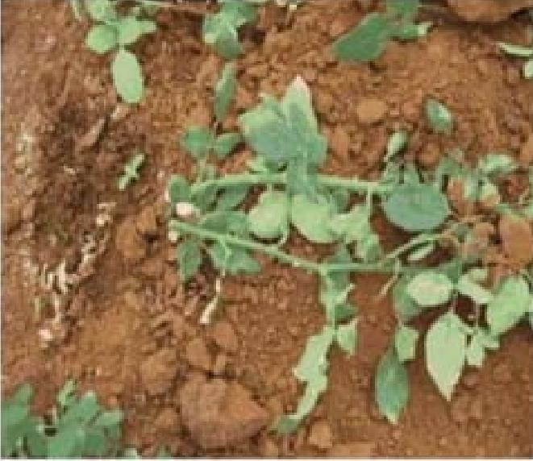
Cultural Practices in rose/ Growth Regulation
Bending
  to obtain quality flowers with long stalk length
  to encourage the plant for healthy framework at the bottom
  to active more number of side shoots
  Only weak and blind shoots are selected for bending
The first bending is done on 35th days after planting and
the second bending is done after 2 years to strengthen the plants.
B.Sc. (Ag.) IV Sem. (Production Technology for Ornamental Crops, MAP and Landscaping)

Slide 19
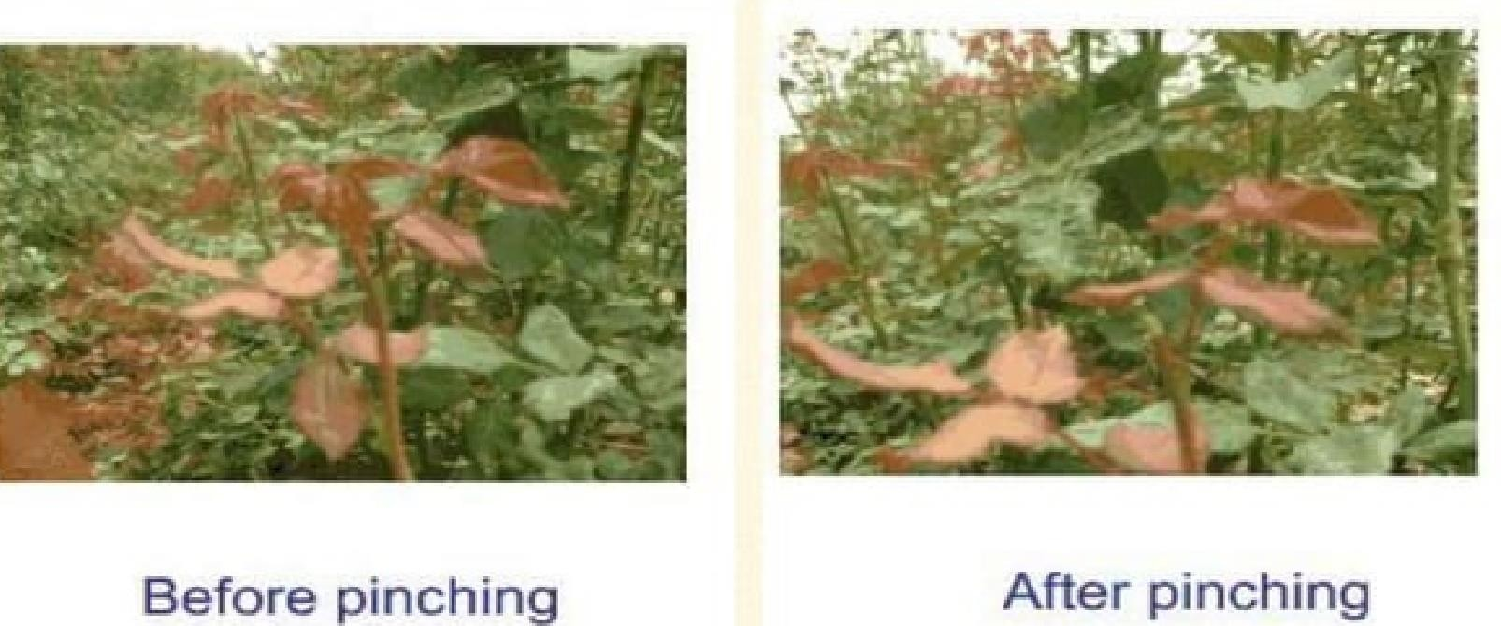
2. Pinching
Removing the terminal growing portion along with a portion of stem is called pinching.
B.Sc. (Ag.) IV Sem. (Production Technology for Ornamental Crops, MAP and Landscaping)

Slide 20
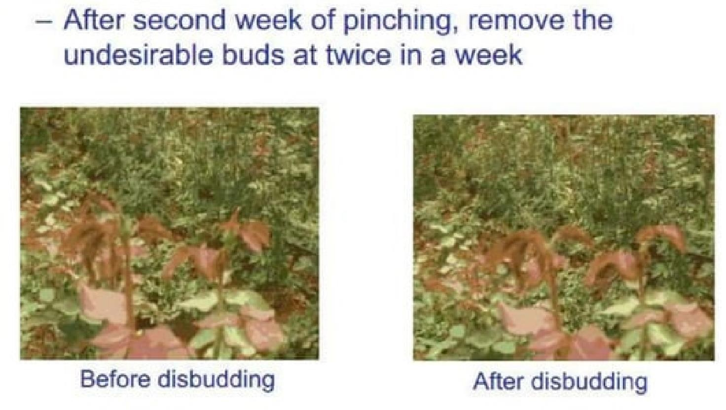
3. Disbudding
B.Sc. (Ag.) IV Sem. (Production Technology for Ornamental Crops, MAP and Landscaping)

Slide 21
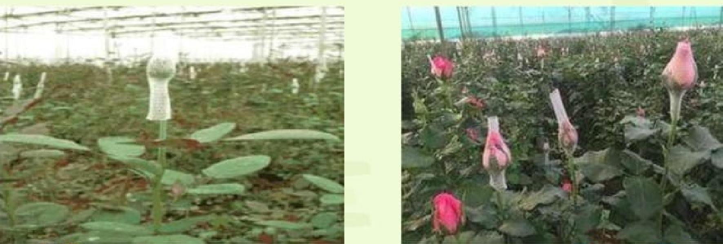
4. Bud capping
Bud caps are placed on the flower bud when they are of pea size.
This helps to increase the bud size and shape to meet custome demand with required specification.
B.Sc. (Ag.) IV Sem. (Production Technology for Ornamental Crops, MAP and Landscaping)

Slide 22
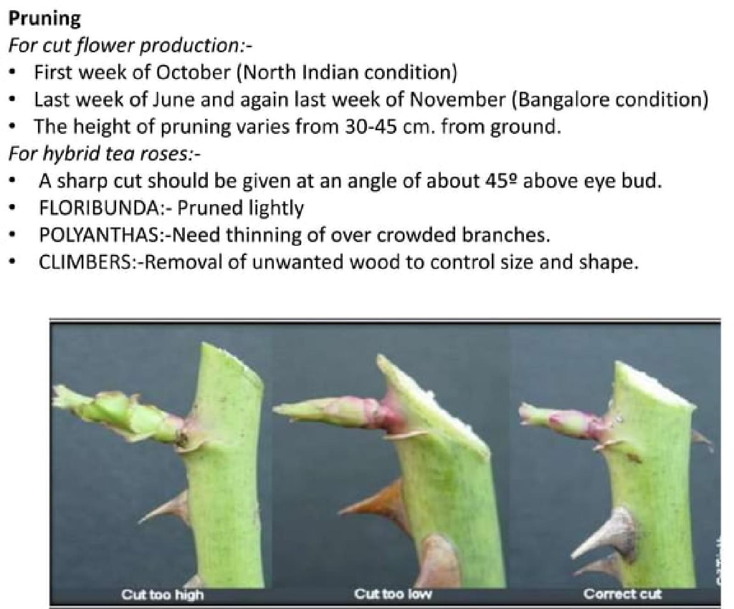
B.Sc. (Ag.) IV Sem. (Production Technology for Ornamental Crops, MAP and Landscaping)

Slide 23
Harvesting
Should be harvested at tight bud stage when one or two petals begin unfold with the help of sharp secateure.
Red and pink cultivars are harvested when first 2 petals are beginning to unfold and calyx is reflexed below the horizontal lane, whereas,
yellow cultivars are harvested slightly earlier and white cultivars slightly later than red and pink type cultivars.
There should be 1-2 mature leaves (those with five leaflets) left on the plant after the flower has been cut.
The reason for leaving these matures leaves is to encourage production of new strong shoots. Harvesting is done preferably during early morning hours.
B.Sc. (Ag.) IV Sem. (Production Technology for Ornamental Crops, MAP and Landscaping)

Slide 24
Flower Yield -
Approx. 250-350 stems/m2 is considered to be ideal.
Flower yield can be increased by spraying BAP 50-100 ppm before flowering flush.
Burning of saw-dust during winter months in the morning hours (7-10 AM) increases flower yield and quality significantly
B.Sc. (Ag.) IV Sem. (Production Technology for Ornamental Crops, MAP and Landscaping)

Slide 25
Post-harvest Handling
Roses cut stems must be placed in a bucket of water inside the polyhouse immediately after harvesting and transported to cold storage (2-4°C).
The length of time depends upon the variety and quality of the roses. The rose flowers are graded according to the stem length and the quality of flower bud.
Graded flowers are grouped together in bunches of 10, 12, 20 or 25.
A bundle of 20 stems is usually preferred.
Packing with polypropylene (24 micron) is highly effective storage technique for rose, to maintaining post storage quality and vase life.
B.Sc. (Ag.) IV Sem. (Production Technology for Ornamental Crops, MAP and Landscaping)

